Slide 1
PERFORMANCE ANALYSIS OF AODV, OLSR, DSR AND GRP ROUTING PROTOCOL OF MOBILE ADHOC NETWORK – A REVIEW
IJCSMC, Vol. 2, Issue. 6, June 2013, pg.359 – 362
Suchita Baxla, Prof. Rajesh Nema
Department of Electronics & Communication, NRI College, Bhopal, M.P, India
Department of Electronics & Communication, NRI College, Bhopal, M.P, India
Suchi_baxla@rediffmail.com; Rajeshnema2010@rediffmail.com
Speaker: Arak
Date : 2014-1-23

Slide 2
Outline
Introduction
Reactive routing protocol
AODV, DSR
Proactive routing protocol
OLSR
Hybrid routing protocol
GRP
Conclusion
References

Slide 3
Introduction
MANET(Mobile Ad hoc Network)
An ad hoc or temporary wireless network
There are no dedicated routers, servers, access points, base stations and cables
Transmission
Directly (transmission range)
Forward (otherwise)
Every node has to function as a router

Slide 4
Introduction
Ad hoc Routing Protocols
Classification of routing protocols
By routing strategy
table-driven (Proactive)
on demand or source initiated (Reactive)
By network structure
flat routing
hierarchical routing
geographic position assisted routing
Most popular methods
proactive routing
reactive routing
hybrid routing
Flat Routing
Hybrid Routing
Reactive
Proactive
AODV
DSR
TORA
DSDV
OLSR
WRP
FSR
ZRP
CEDAR
ZHLS
DDR

Slide 5
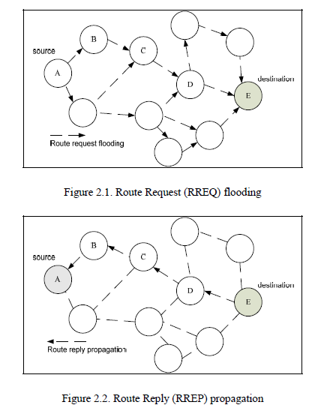
Reactive routing protocol
Ad Hoc on-Demand Distance Vector Routing (AODV)
Constantly sending “hello messages”
Gone down or moved out of reach
RREQ, RREP messages
Dynamic Source Routing (DSR)
Pure on demand protocol
Both route discovery and maintenance
are on demand
Routing overhead traffic scales to actual
needed size

Slide 6
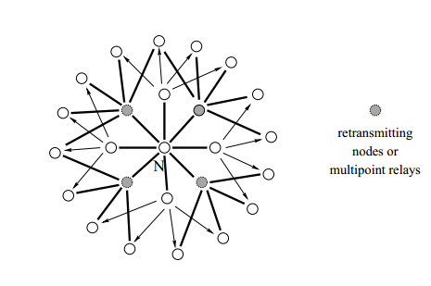
Proactive routing protocol
Optimized Link State Routing (OLSR)
Pure link state protocol
Periodic control message
Suitable for large and dense ad hoc network
MPRs(Multipoint Relays)
MPR nodes are selected as intermediate nodes in
the path

Slide 7
Hybrid routing protocol
GRP (Gathering-based Routing Protocol)
short transfer delay and small overheads
But complexity and overhead required

Slide 8
Table 1: Comparison between the three categories of routing protocols

Slide 9
Conclusion
presented and discussed the routing protocols in mobile ad hoc networks and provided comparisons between them
Which one is the best?
Each routing protocol has unique features
still many challenges facing wireless ad hoc networks
Power consumption
Speed
each protocol has their own merits and demerits and is well suited for certain situations
it is not clear that any particular algorithm or class of algorithm is the best for all scenarios

Slide 10
References
Performance analysis of AODV, OLSR, DSR and GRP routing protocol of mobile Ad hoc network – a review
Optimized Link State Routing Protocol for Ad Hoc Networks

